Slide 1
CLASS 2: PYTHON FOR DATA SCIENCE

Slide 2
Recap
What is Data Science?
Data Science Workflow
Unix class work

Slide 3
Agenda
Questions from last Exit Ticket
Why Python?
Programming workflow and tools review
Python in the terminal
Python Lab
Pandas review
Pandas Lab

Slide 4
Exit Ticket Questions
What is the actual curriculum? (class github)
Keys to success in class?
Difference between analytics & data science?
How to view markdown files?
When would I need to use something like python?
Advantages of python over other languages?
Why use ipython/Jupyter?
Why learn bash?
What are the appropriate models to use?

Slide 5
I. INTRO TO PYTHON

Slide 6
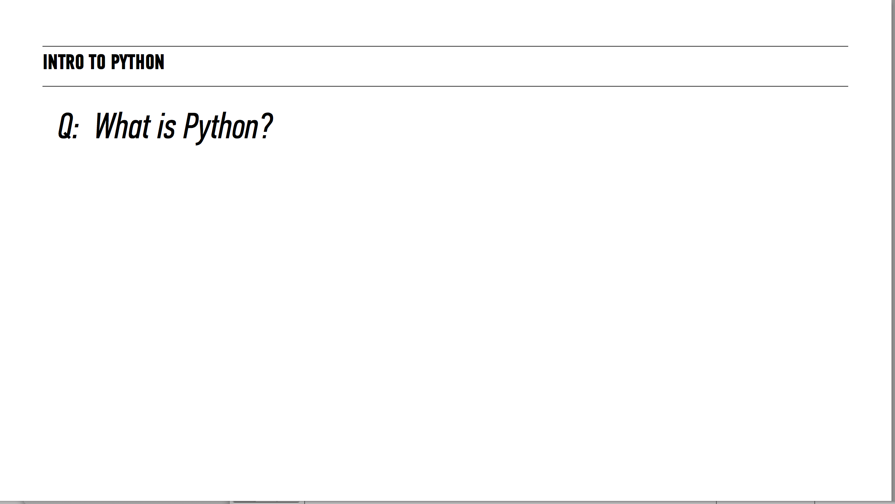

Slide 7
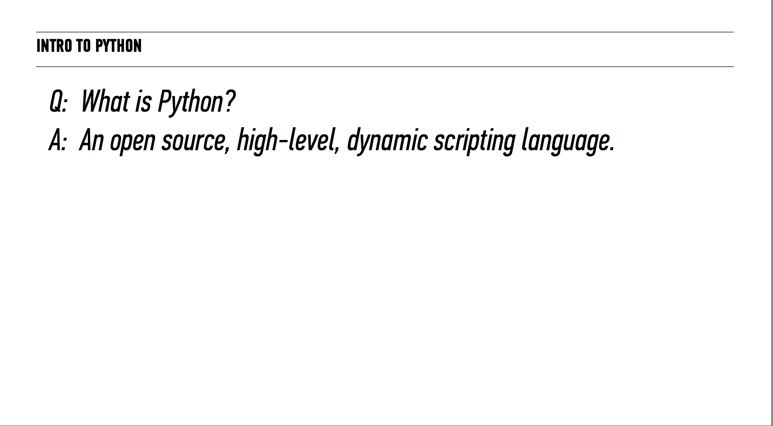

Slide 8
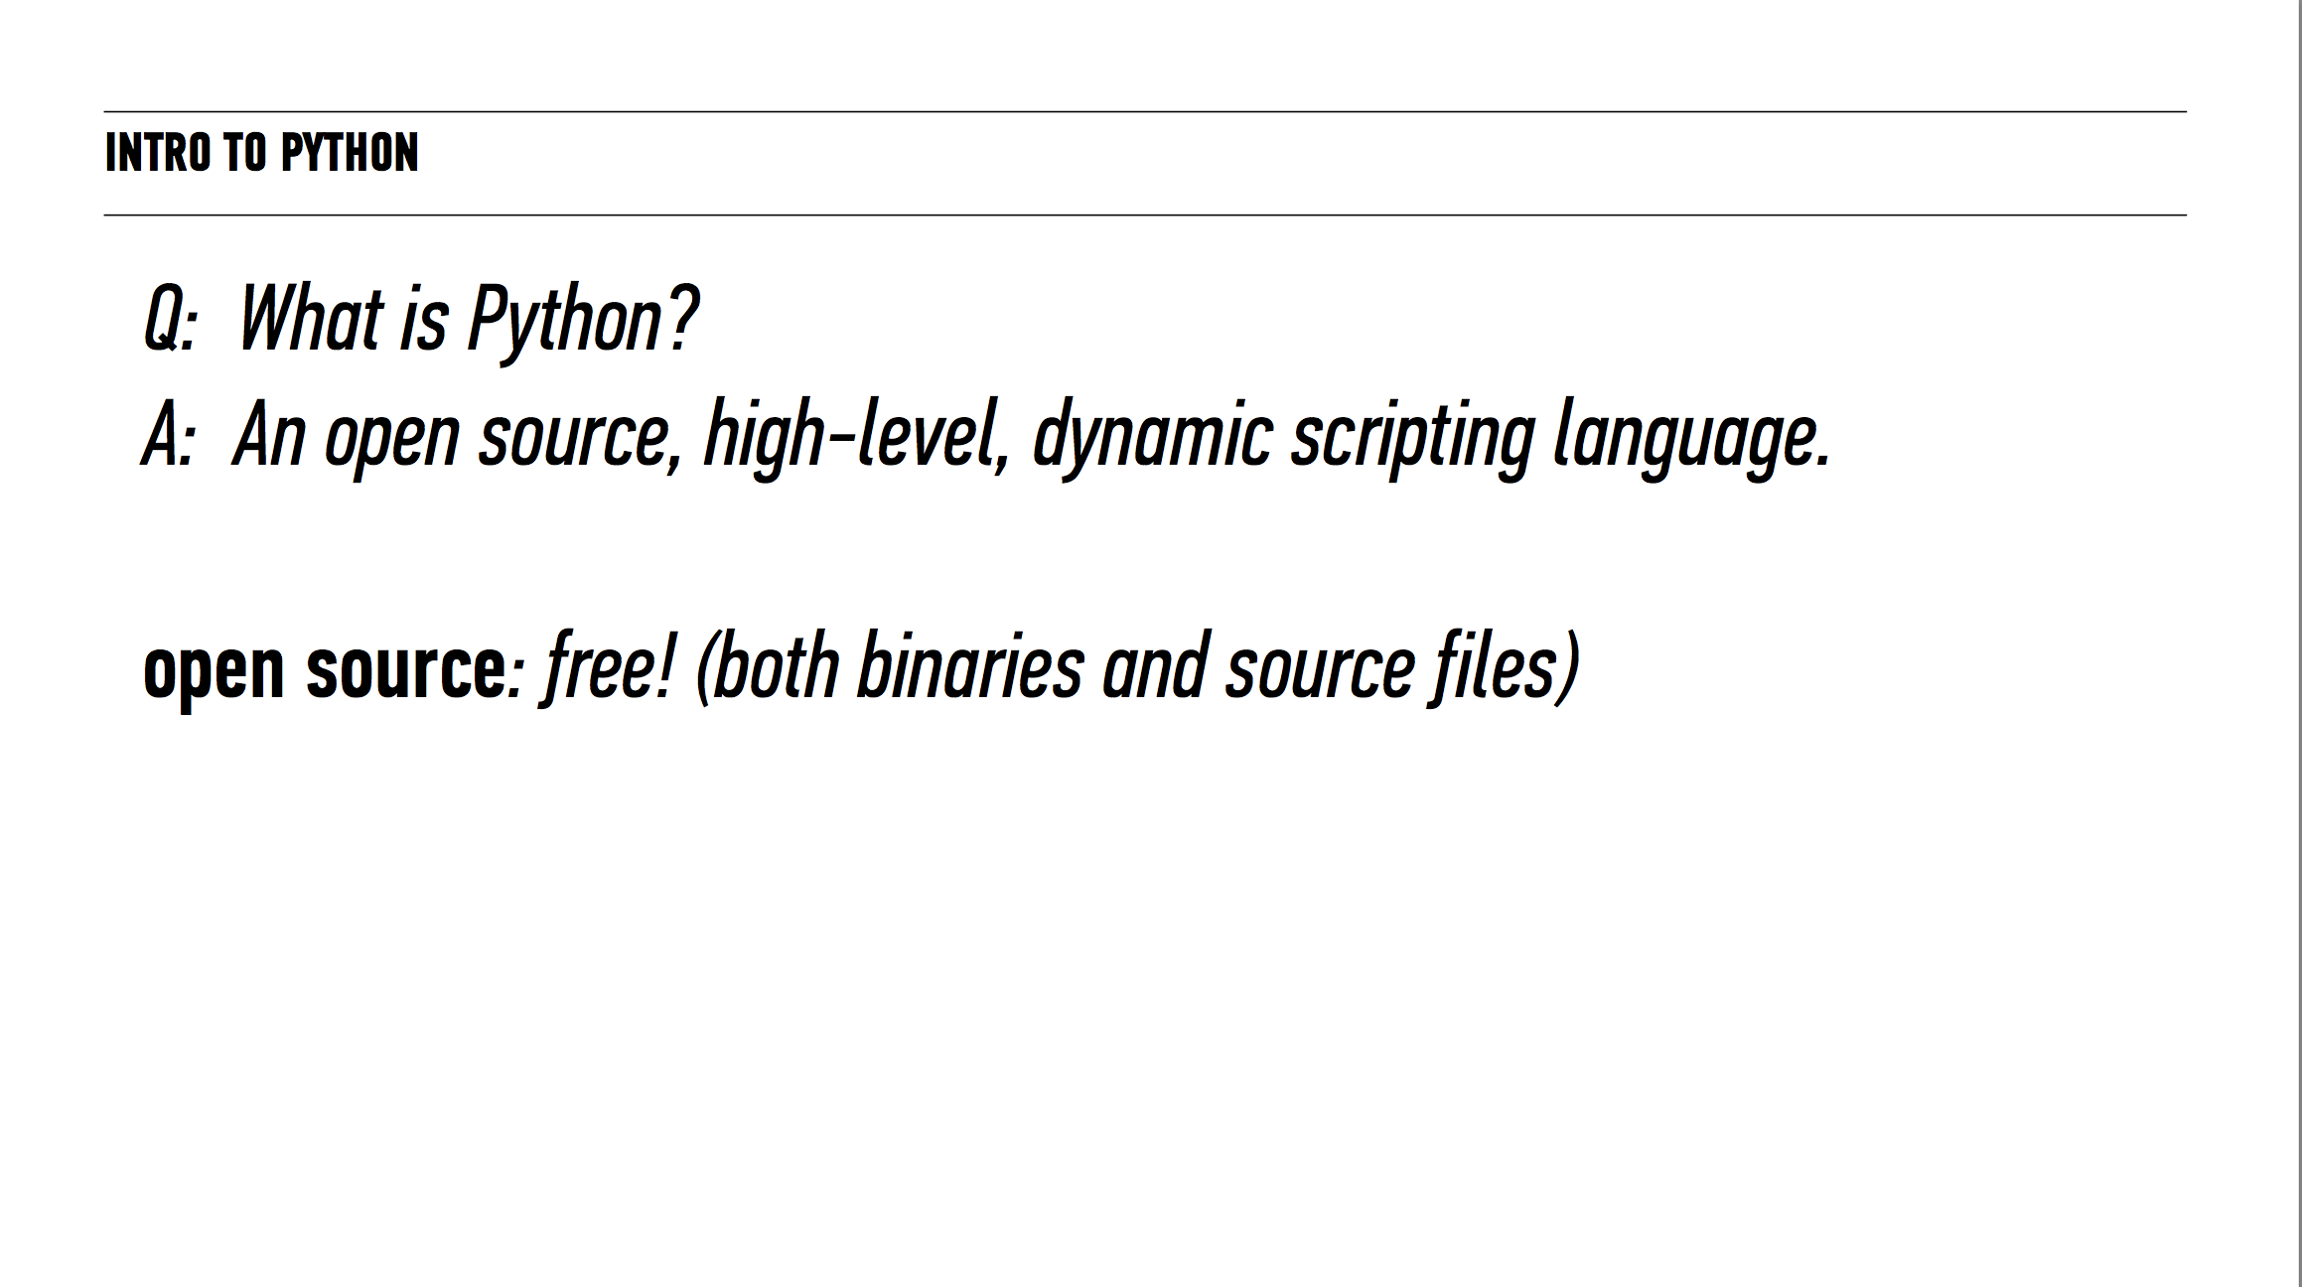

Slide 9
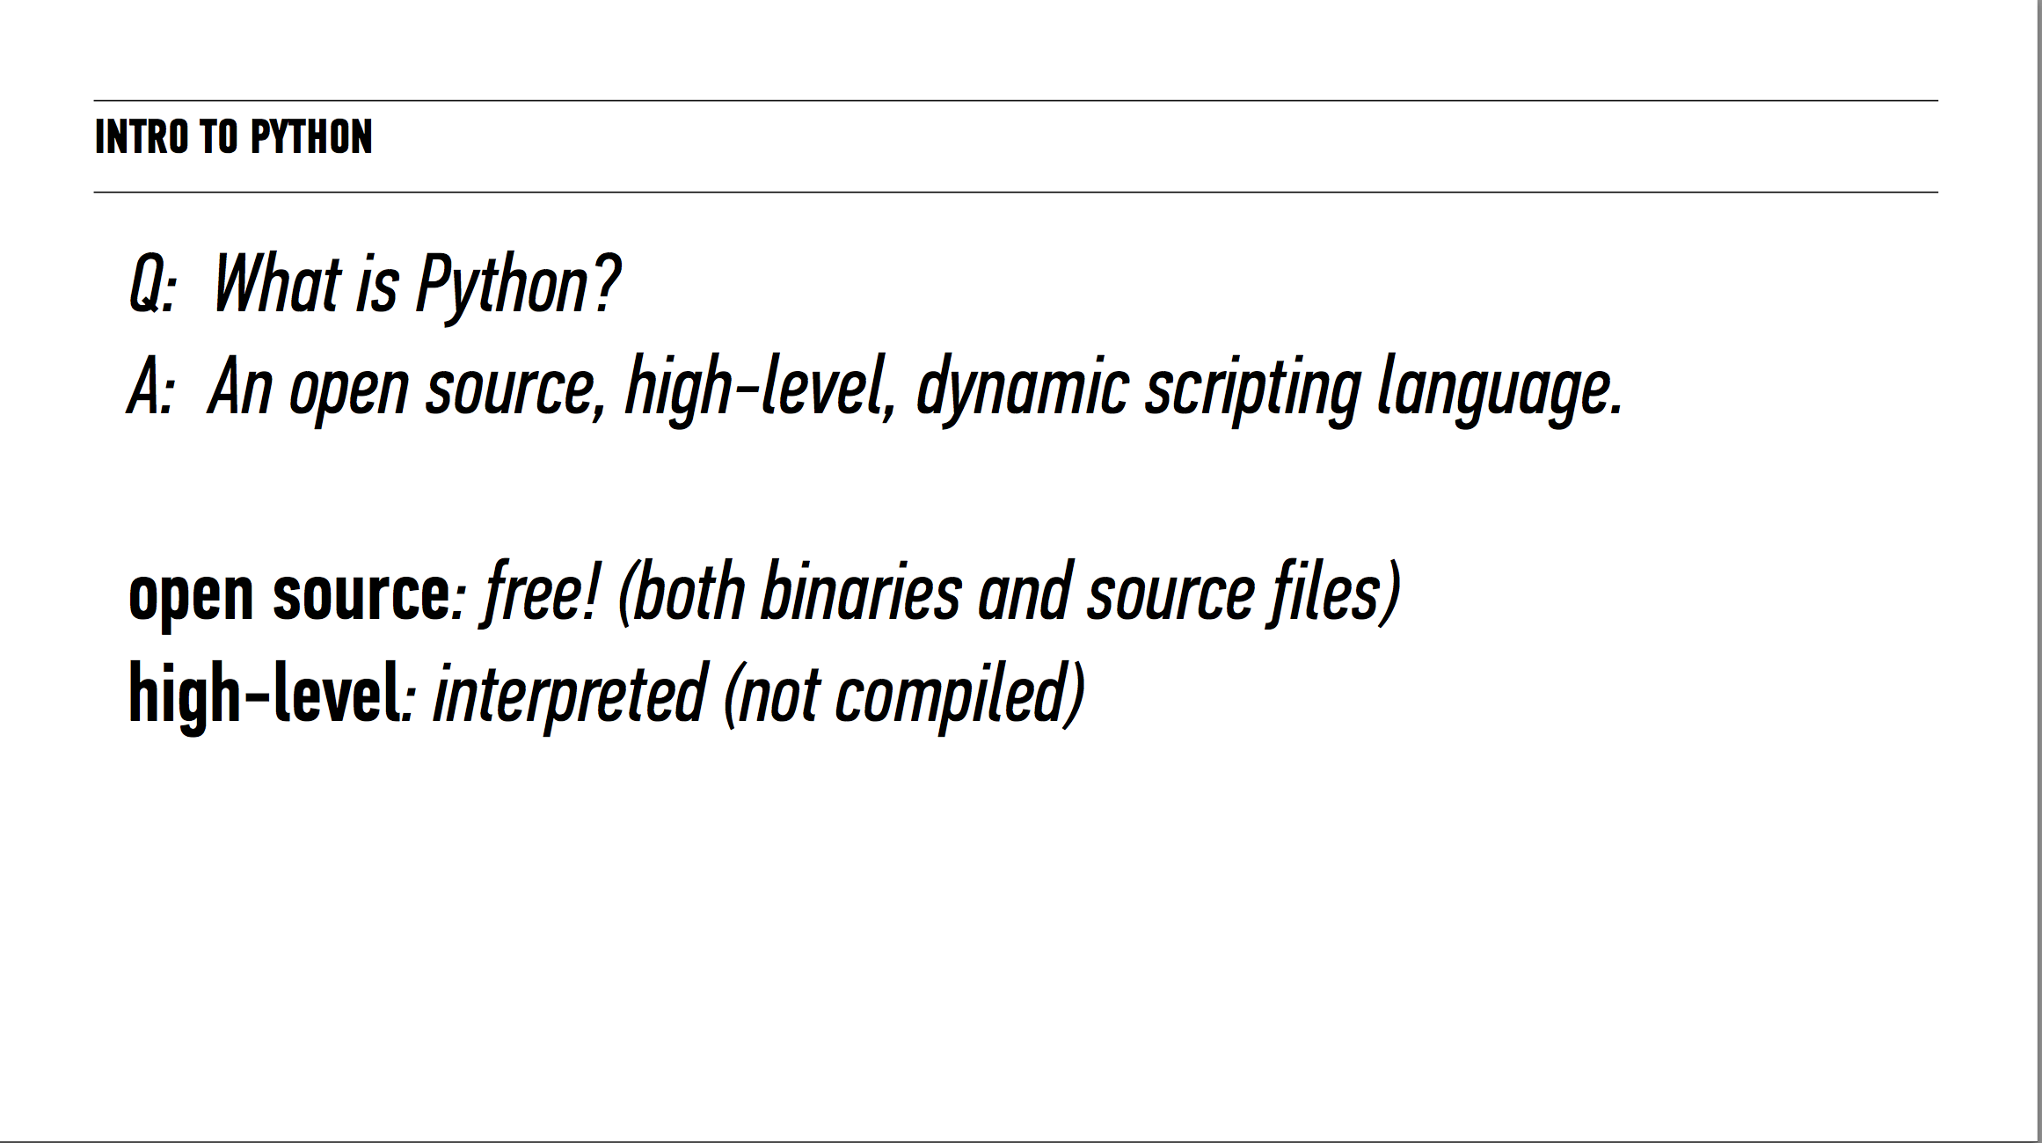

Slide 10
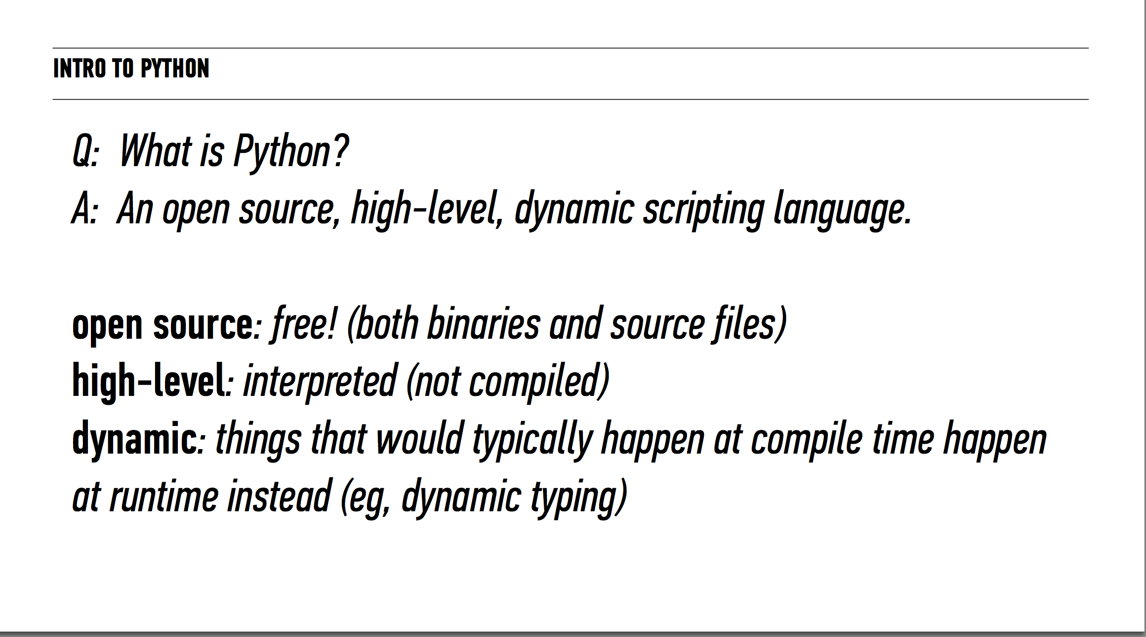

Slide 11
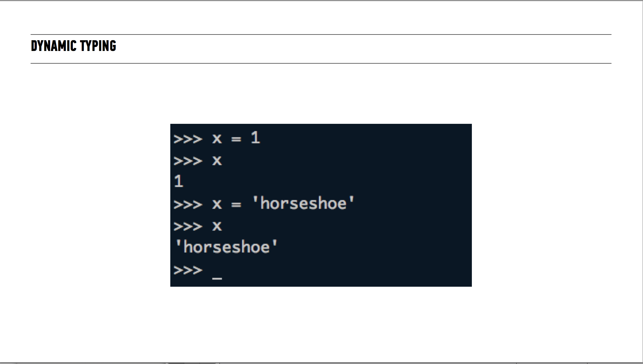

Slide 12
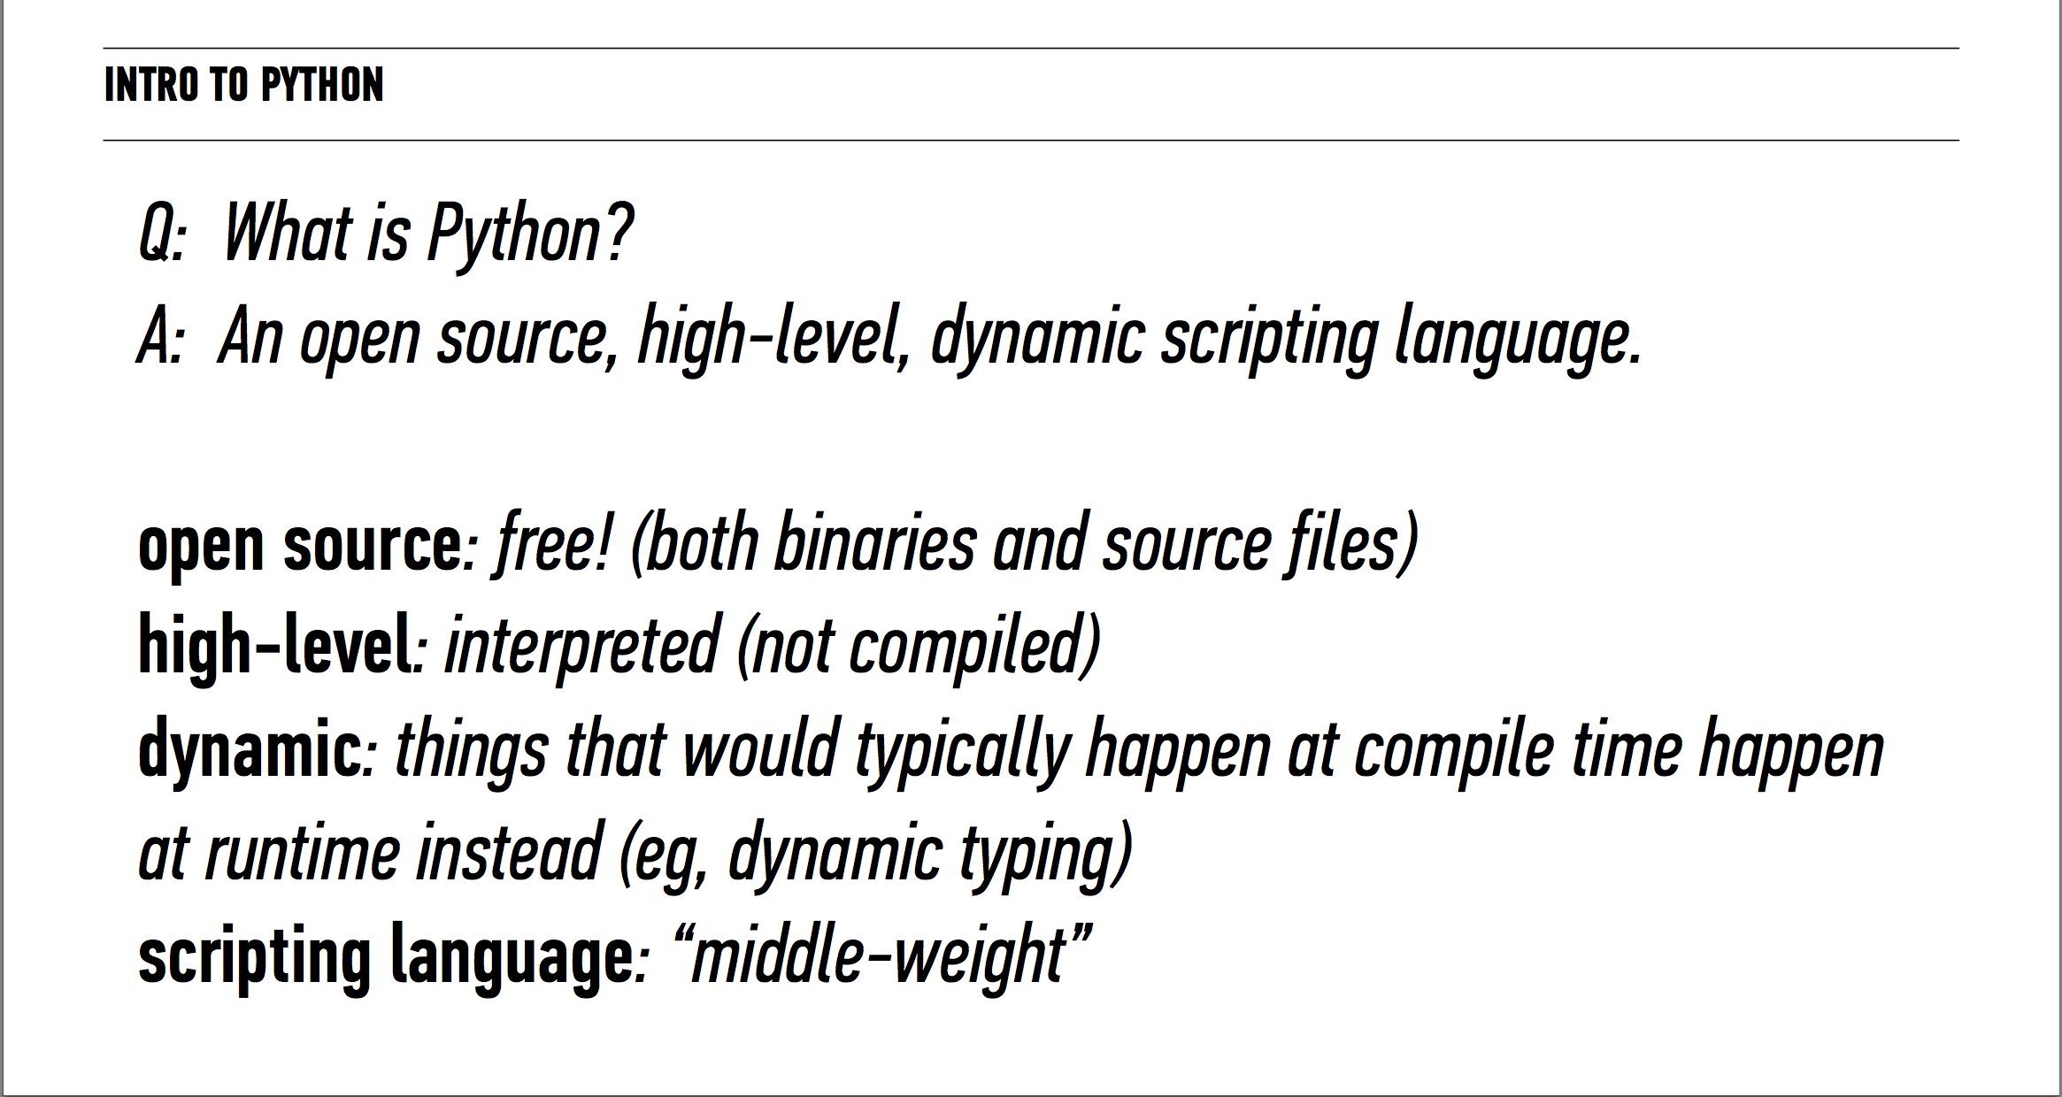

Slide 13
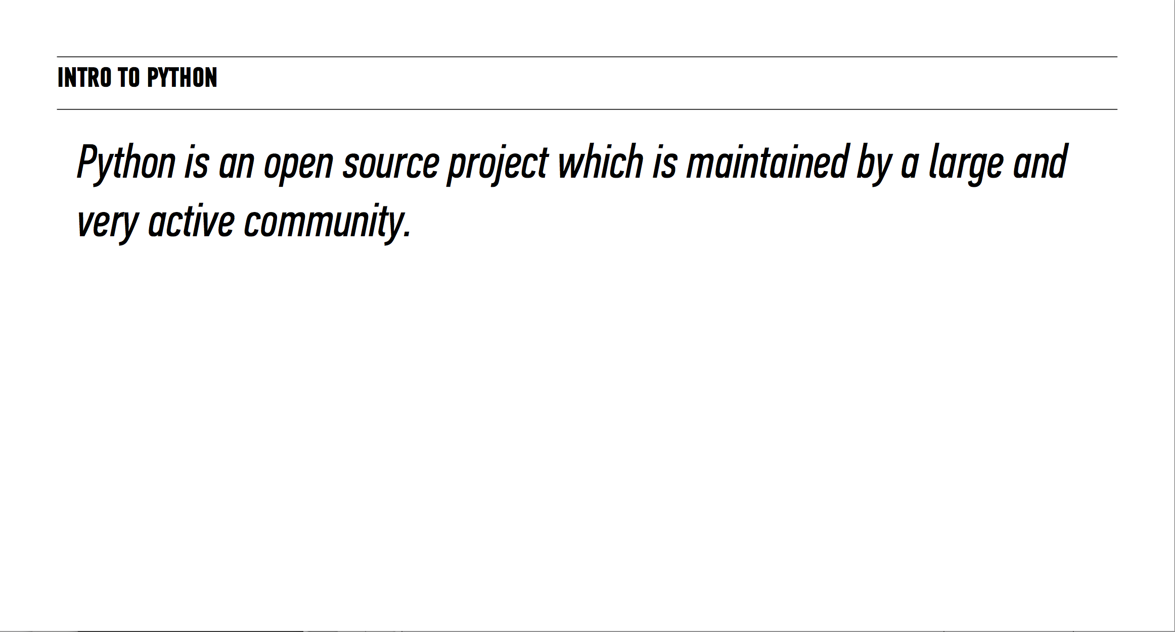

Slide 14
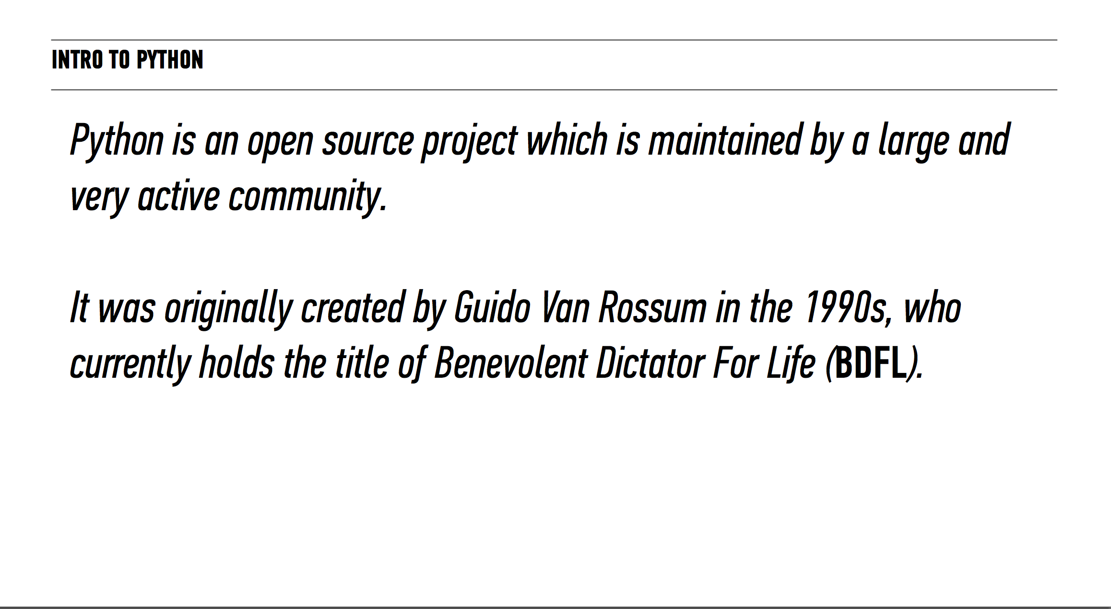

Slide 15
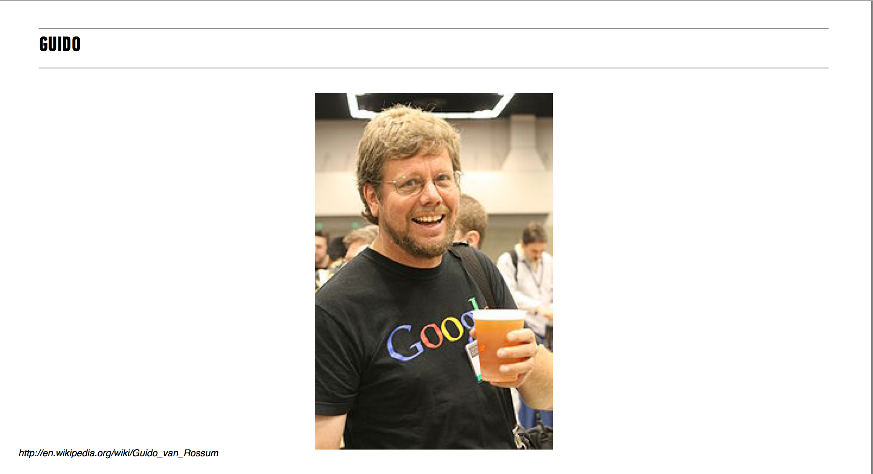

Slide 16
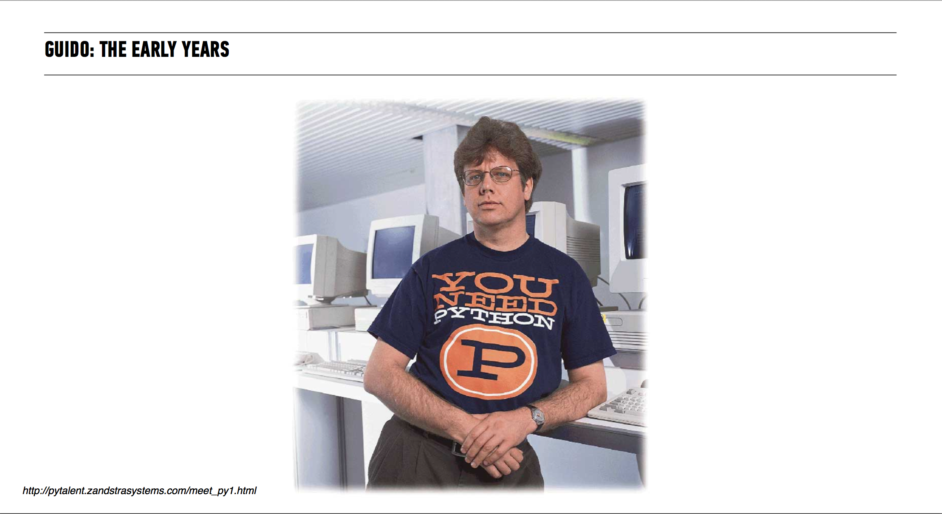

Slide 17
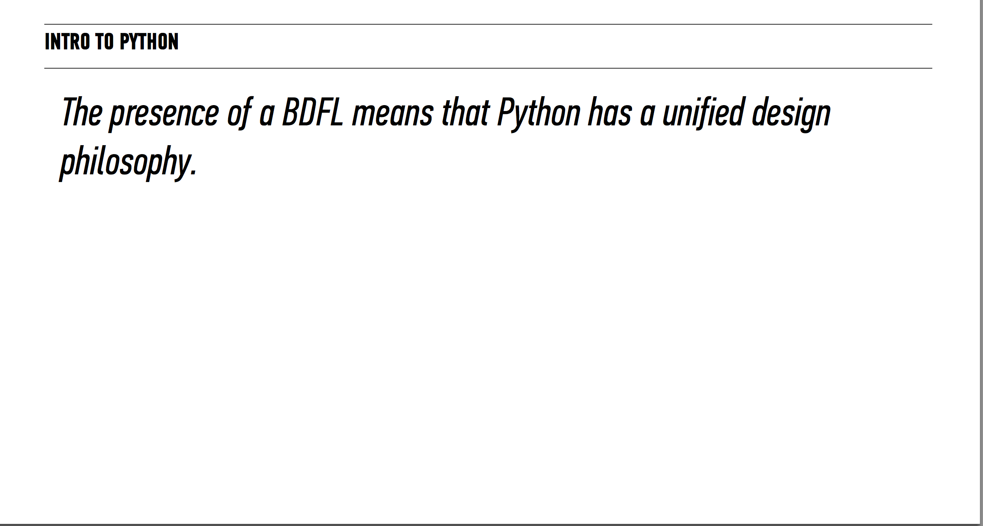

Slide 18
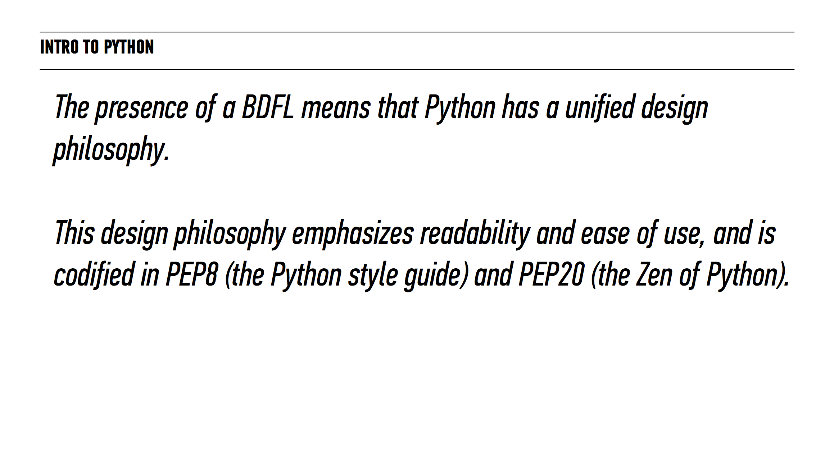

Slide 19
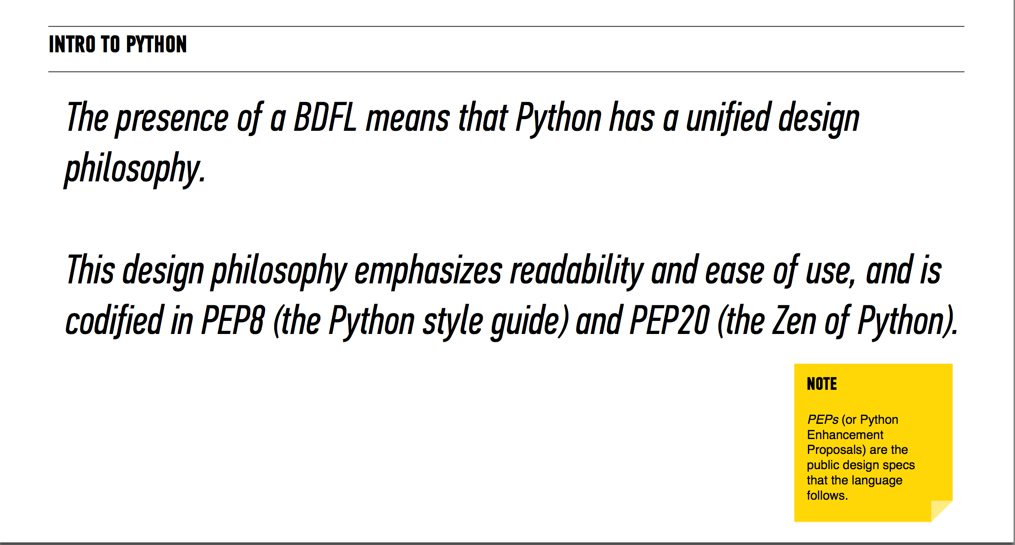

Slide 20
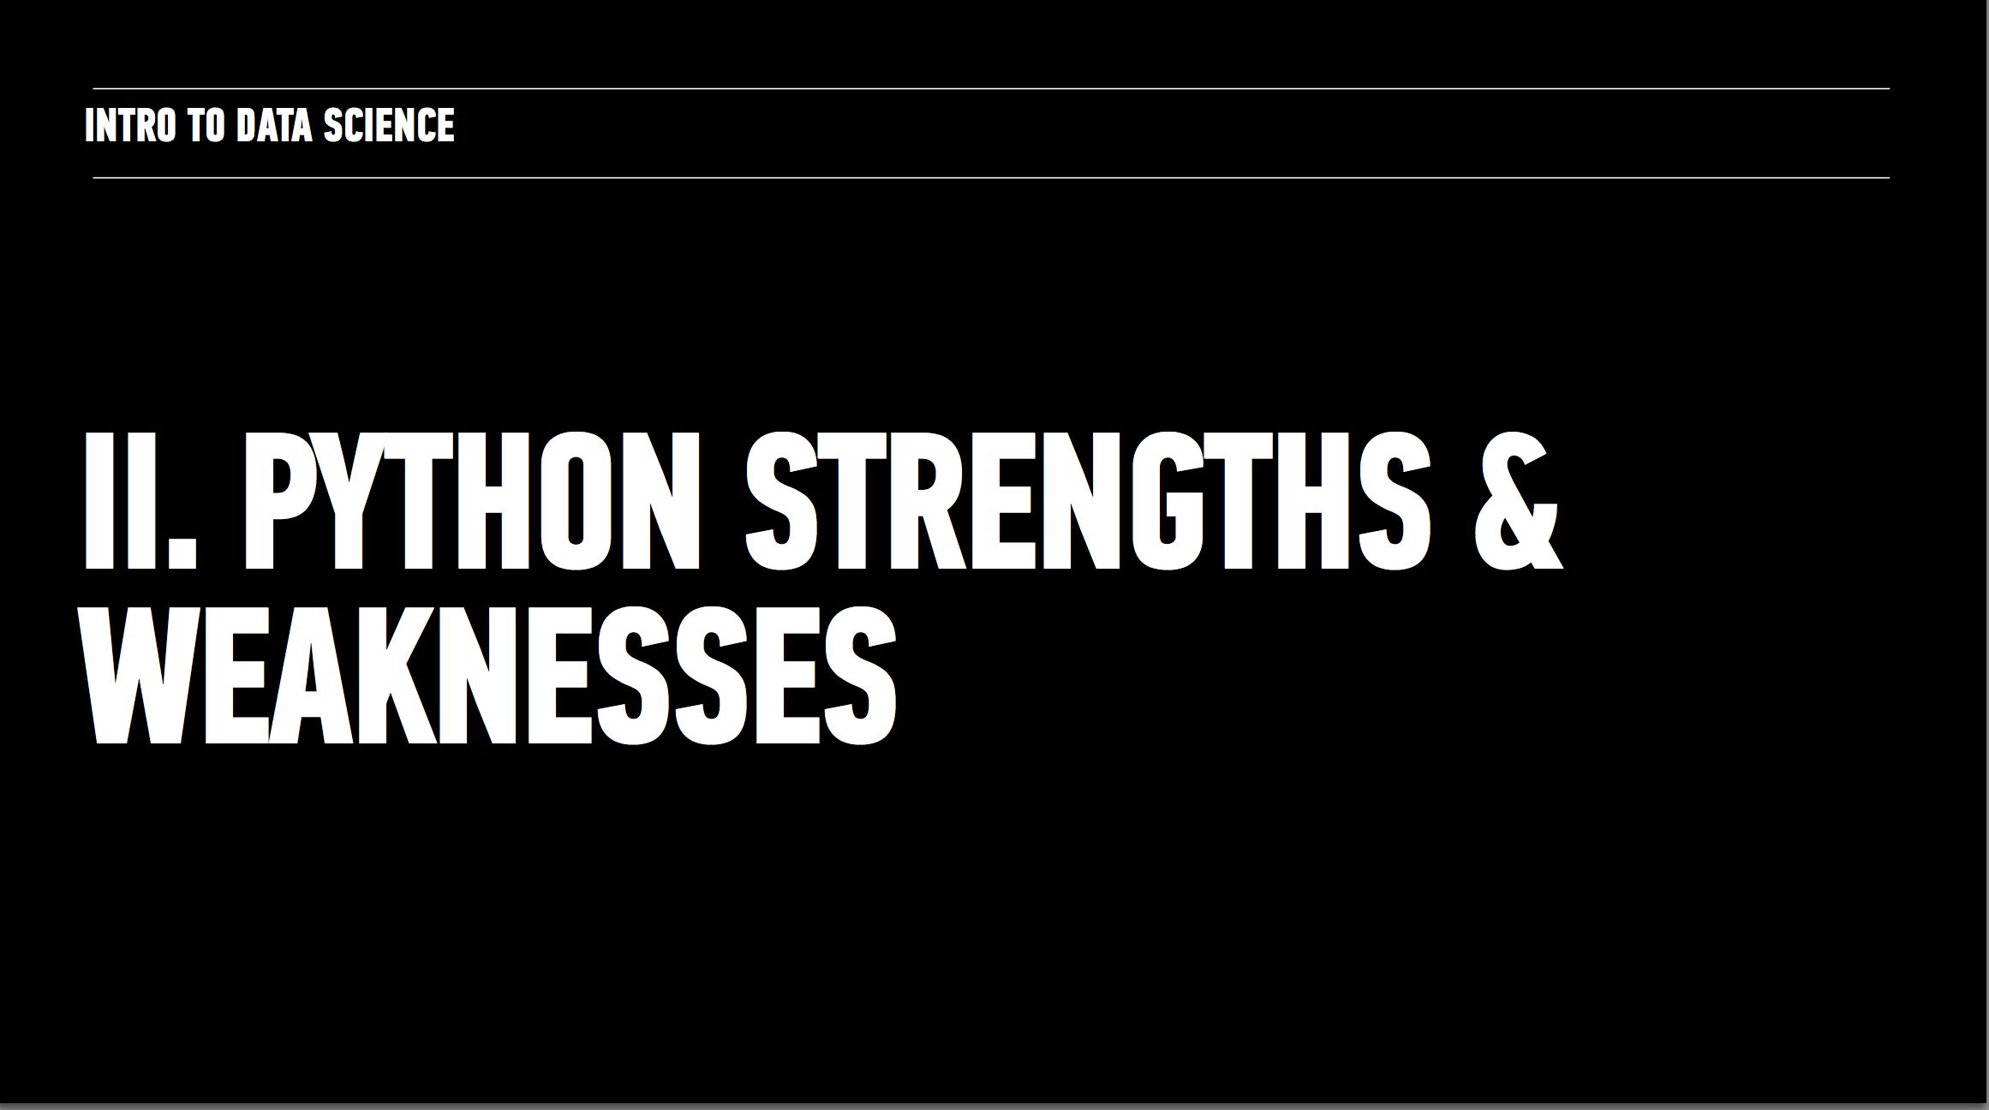

Slide 21
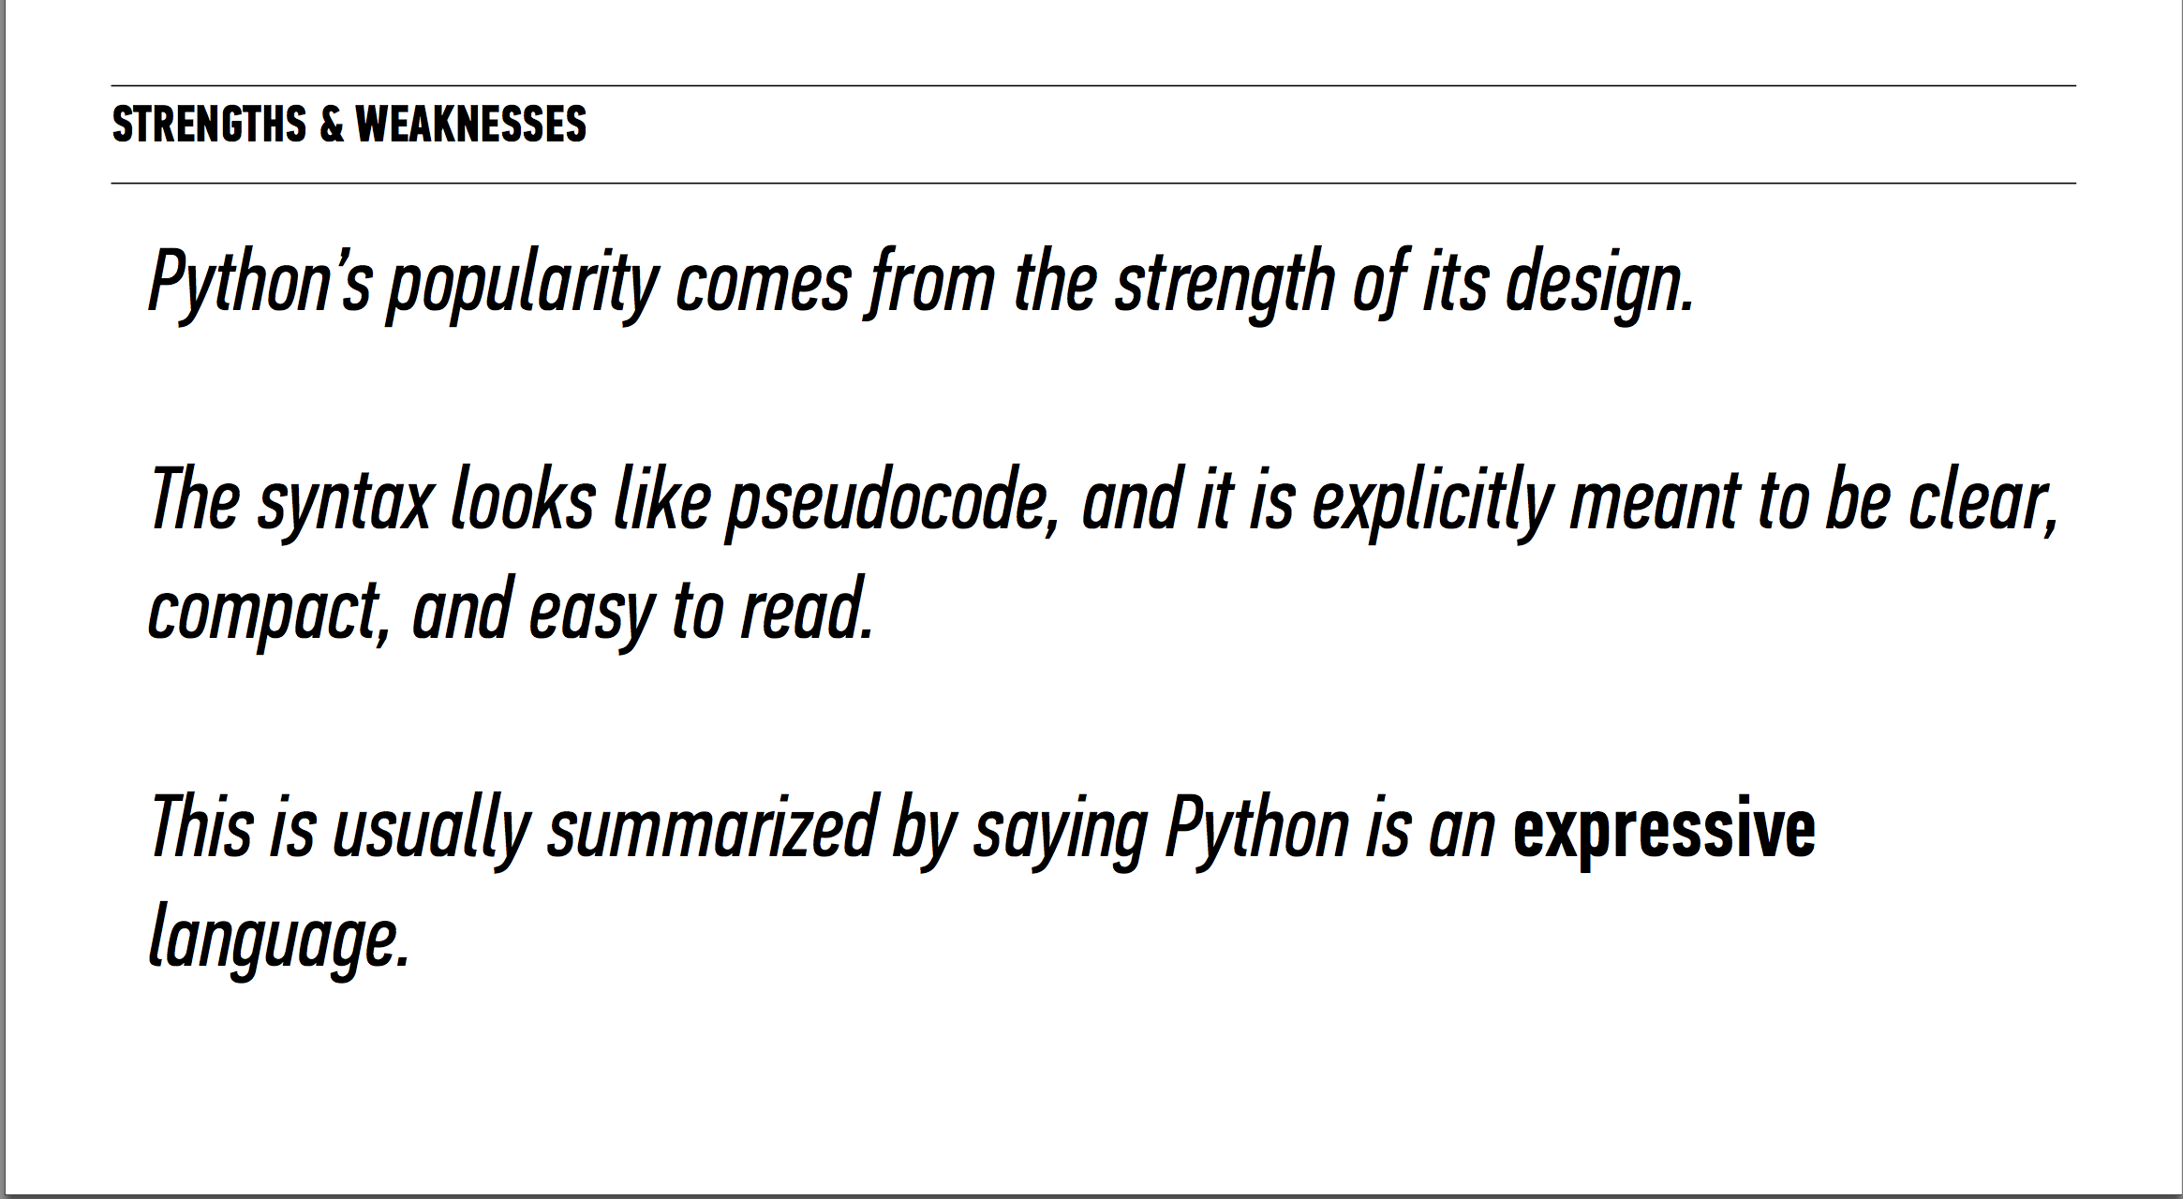

Slide 22
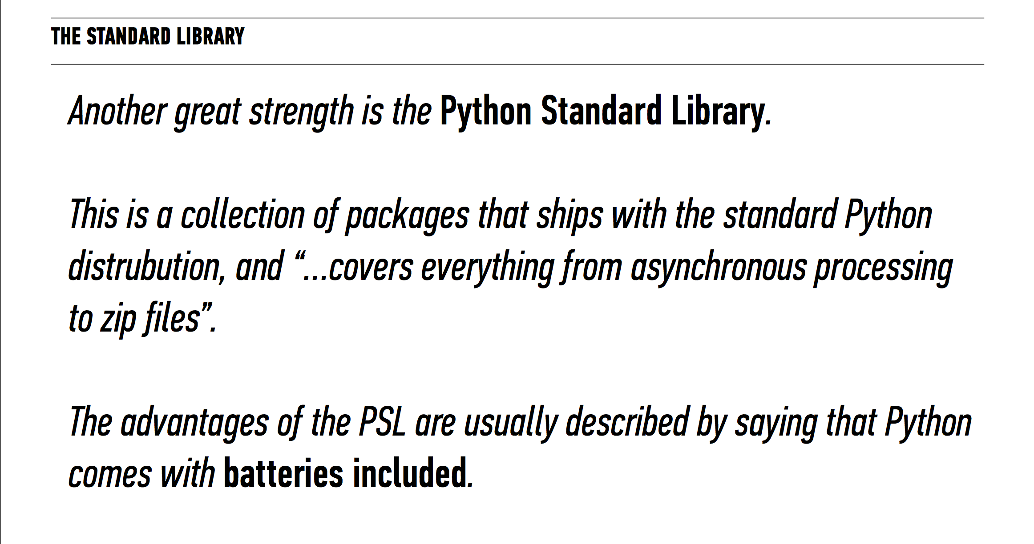

Slide 23
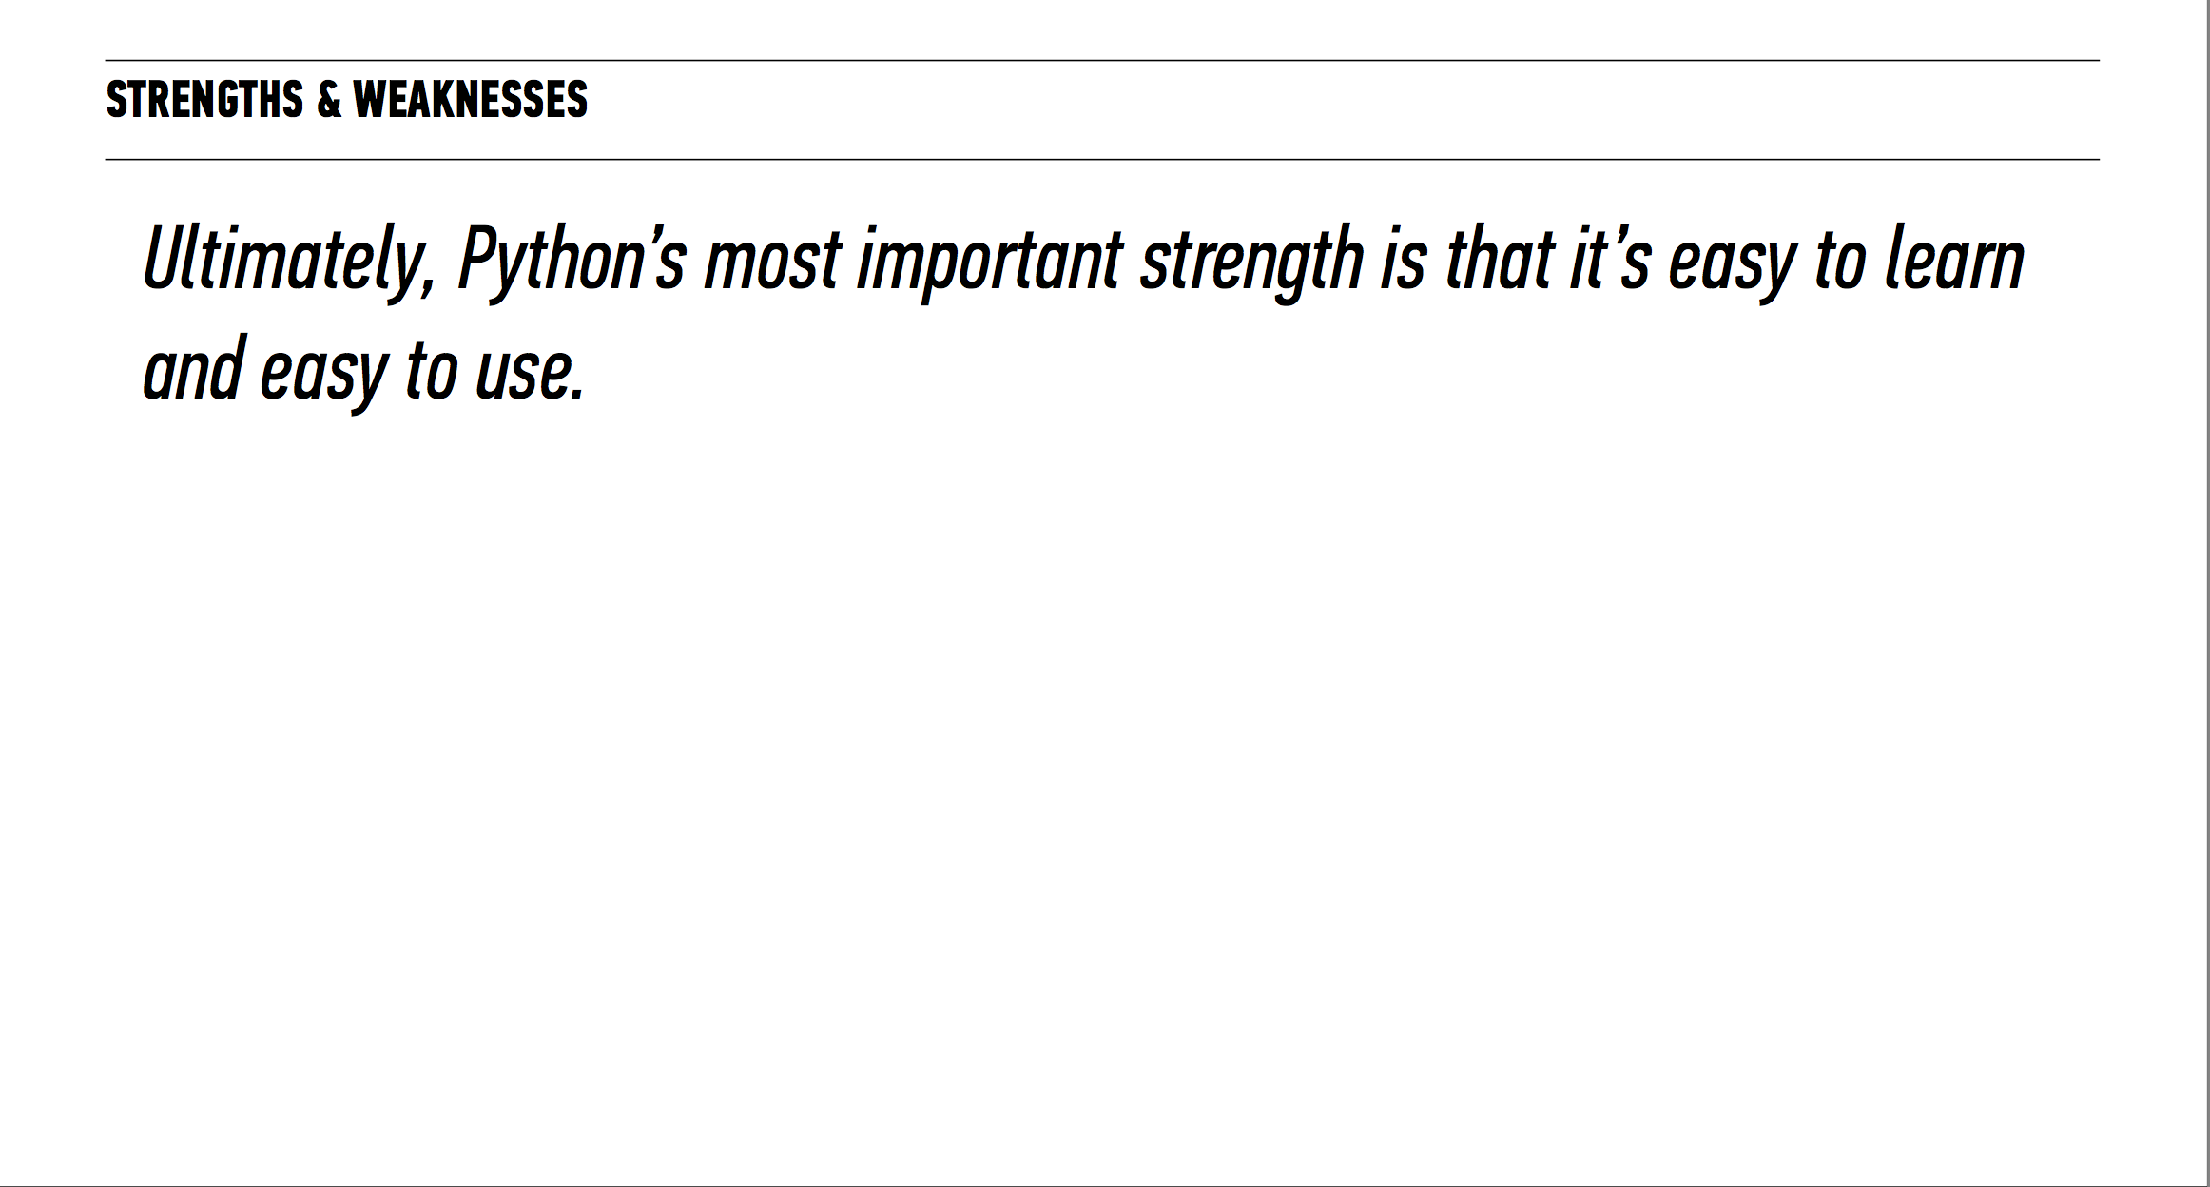

Slide 24
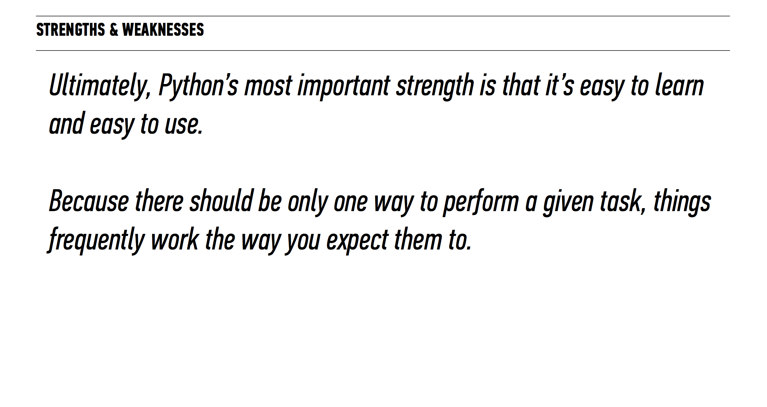

Slide 25
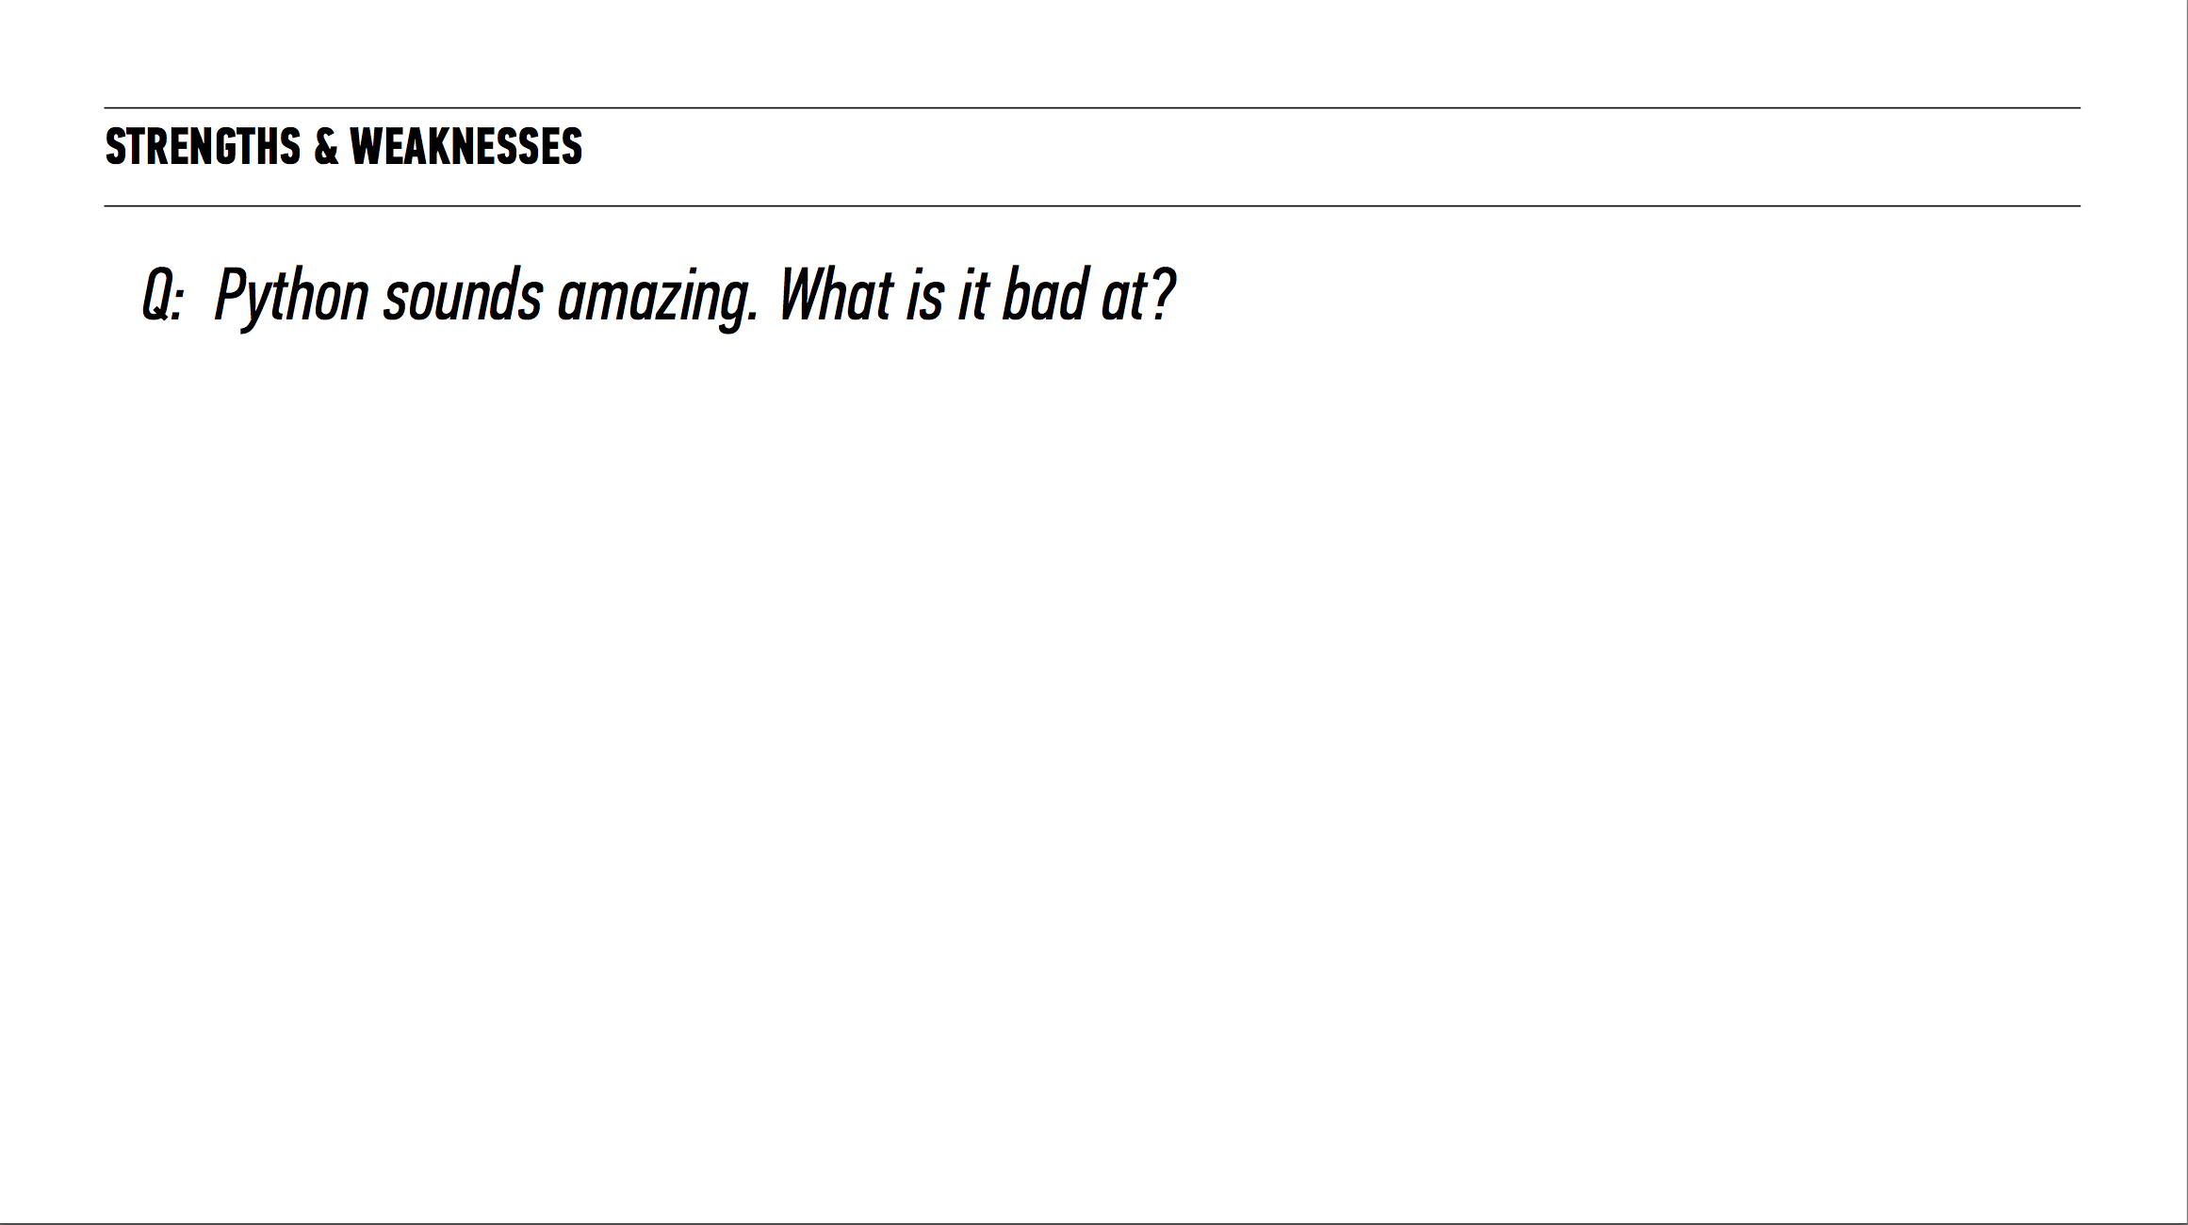

Slide 26
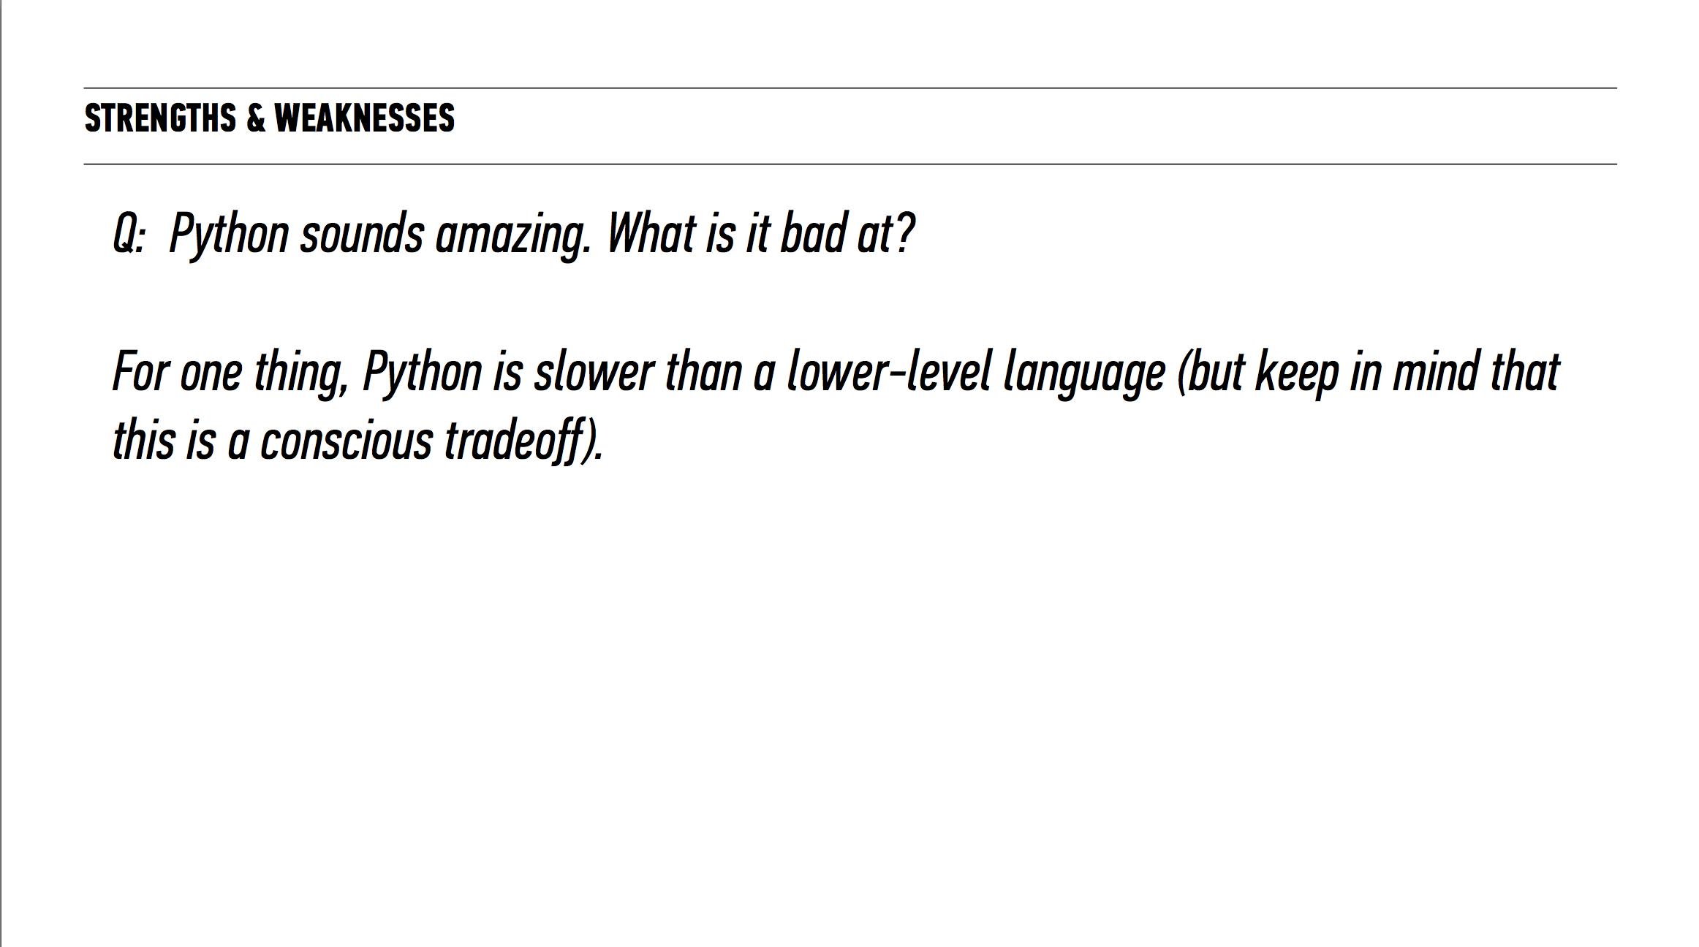

Slide 27
INTRO TO DATA SCIENCE
IPython Lecture

Slide 28
INTRO TO DATA SCIENCE
III. PANDAS

Slide 29
Pandas
Built by a quantitative trader at a firm called AQR.
Had certain requirements:
Data structures with labeled axes
Integrated time series functionality
Same data structure to handle both time series and non-time series
Arithmetic operations and reductions (like summations across axes)
Flexible handling of missing data
Merge and other relational operations found in SQL like databases

Slide 30
Pandas
Pandas is:
A library that allows you to work with structured data quickly and easily
Very fast. Combines high performance features of numpy with flexible data manipulation capabilities of spreadsheets and databases
Heavily influenced by the R programming language

Slide 31
Pandas – Data Structures
Series | DataFrame
One dimensional – just an array of data, and an associated array of labels, called an index | Represents tabular spreadsheet-like data structure containing a collection of columns, each of which can be a different value type. It can be thought of as a dict of Series

Slide 32
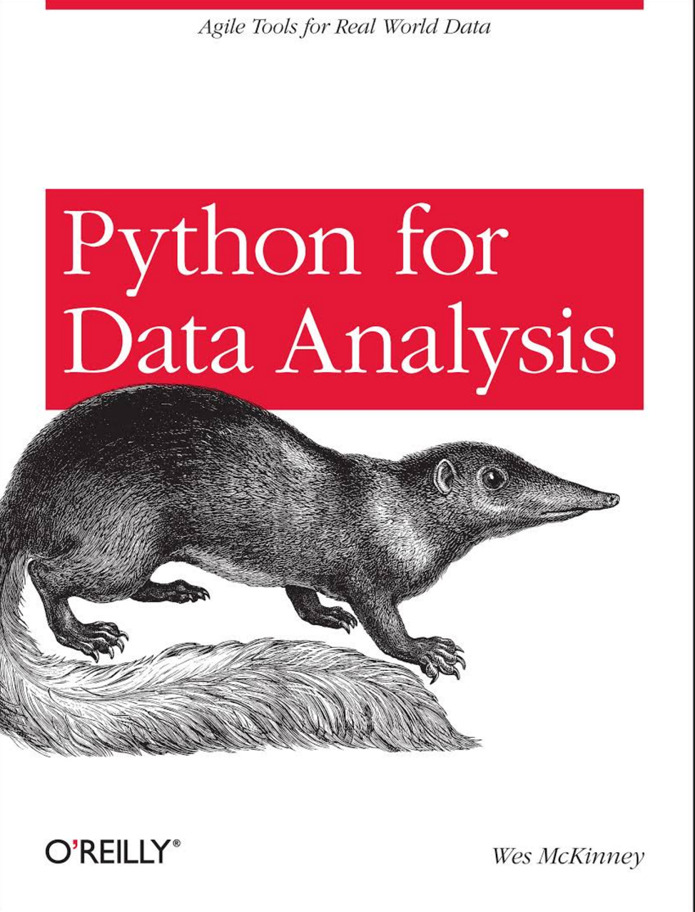
Pandas – Data Structures
Pandas has some incredible functionality (as we’ll soon see).
Becoming great with pandas is a huge step towards becoming great with data manipulation

Slide 33
INTRO TO DATA SCIENCE
IV. PANDAS IPTYHON LECTURE

Slide 34
INTRO TO DATA SCIENCE
V. EXIT TICKET

Slide 35
TODAY
Deep dive into python and programming tools
Described the programming landscape
Created our first iPython Notebook from scratch became familiar with how to work with data in python with the pandas library
Preview of plotting and time series
Notes:
Feedback is a part of the GA experience. It is used to tweak the DAT experience from instance to instance. Helps instructors know what’s working well and what can be improved. Your producer, Daniel also communicates feedback to the appropriate teams that work behind the scenes at GA.

